Slide 1
Meteor impact visualizer
By meteor experts

Slide 2
Challenge :- Meteor Madness
Problem statement :- To develop an interactive visualization and simulation tool that uses real data to help users model asteroid impact scenarios, predict consequences, and evaluate potential mitigation strategies to enable the public and decision makers to understand and mitigate its risks.
Project :- To create a visualizer which would provide each and every information about the asteroid impact to for scientists, policymakers, and the public to tackle the problem.

Slide 3
Project overview
Innovation:- To create a visualizer which provides the all of the information about the asteroid impact as well as provides the information about the impacts of other natural disaster(Earthquake) so to make it more understandable for the public and decision makers.
Detail explanation:- As we all know that the on earth not all are scientists so that they can themselves know about these high level science. Not all people could understand the these complex data and act according to it. So even if we have these data we cannot ask people to directly act according to it. Therefore would be required to find some way out of it so that the people could understand the data easily. So to solve this complex problem our team had created a user friendly visualizer which helps all category of people to know it through the most recent natural disasters(Earthquake), as the user's can know about it by comparing.

Slide 4
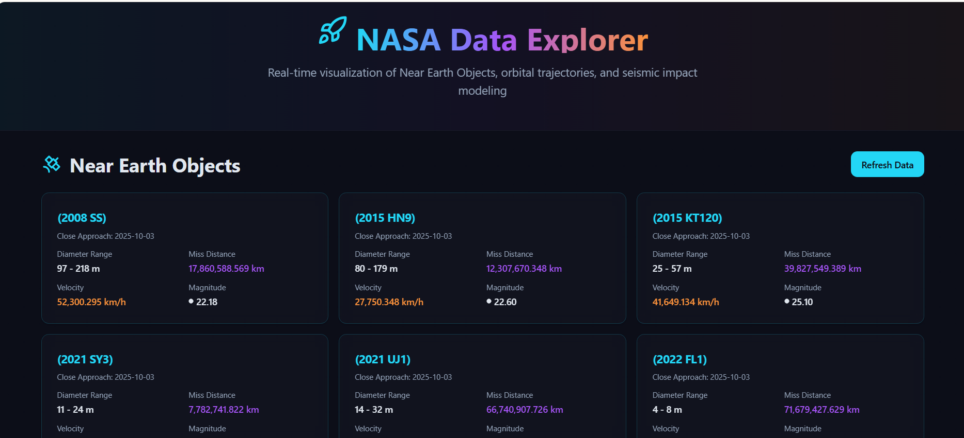
Steps used to complete the challenge:-
Step 1 :- We first created the background using the html foe our visualizer.
Step 2 :- Then we the NASA APIs to fetch the real time data of Near earth Objects.

Slide 5
The code use for the above step is
<code>
API_KEY = "7oKds9xyF5iQjQ2g7EjrAYovS3oatSVNTauN97pL" url = f"https://api.nasa.gov/neo/rest/v1/feed?start_date=2025-10-01&end_date=2025-10-07&api_key={API_KEY}" response = requests.get(url).json() for date, neos in response["near_earth_objects"].items(): for neo in neos: print(neo["name"], neo["estimated_diameter"]["meters"], neo["close_approach_data"][0]["miss_distance"]["kilometers"]) USE the below code to Exact orbital propagation for Impactor-2025 trajectory modeling.
</code>

Slide 6
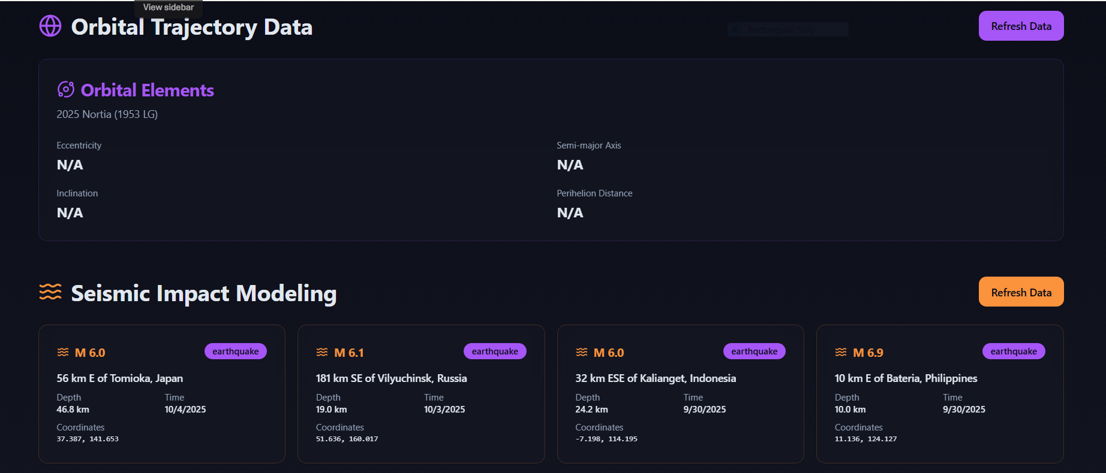
Step 3 :- Later on we used other data provided to create other APIs such as JBL SBDB API, USGS EARTHQUAKE API, etc
Step 4 :- By comparing the data of asteroid Impact with the Seismic Impact Modeling would help to analyze the data.

Slide 7
Future additions:-
1). Add visualizations: Create charts for trajectory paths, impact zones, or magnitude distributions
2). Refine filters: Add date ranges, magnitude filters, or search by specific asteroids
3). 3D visualizations: Integrate Three.js for orbital trajectory animations
Outcome:-
1). Converted multiple APIs data into single API data.
2). Created a user friendly API visualizer to solve the problem by making it easily enable to the public and decision makers to take actions timely.

